Slide 1

DATA ANALYTICS PROJECT
NIKE SALES DATA ANALYSIS
From raw sales records to clear business insights — Data inspection, cleaning, processing, EDA, and visualization.
Team: P. Ganesh · G. Sai Kumar · T. Indravathi · S. Jyothirmayi · M. Anjali
Course: Data Analytics · Tools: Python, Pandas, NumPy, Matplotlib, Seaborn

Slide 2
01 • Project Overview
This project transforms Nike sales records into reliable business insights to answer: revenue performance, product demand, regional performance, and channel contribution. Initial dataset: 2,500 rows × 13 columns befDataset snapshot
Rows: 2,500
Columns: 13
Sales channels: 2 (Online, Retail)
Product lines: 5 (Soccer, Basketball, Running, Lifestyle, Training)
Key fields: Order_ID, Product_Line, Product_Name, Units_Sold, MRP, Revenue, Order_Date, Sales_Channel, Region, Profit.

Slide 3

02 • Data Quality
We assessed completeness, validity and consistency before analysis. Quality checks determine the trustworthiness of all downstream KPIs.
Dataset size
Duplicates found
2,500 × 13
0 (removed where present)
Missing values
Label inconsistencies
Size: 510 entries; Units_Sold: 0 after handling; Other fields affected: MRP, Discount_Applied, Order_Date
Region names (Bengaluru/Bangalore, Hyderabad variants) required standardization
Cleaning choices (e.g., drop vs impute) materially change the interpretation of Units_Sold and derived metrics — document assumptions.

Slide 4
03 • Preparation
Five practical steps were applied to produce an analysis-ready dataset. These steps ensure consistency and enable time-based trend analysis.
01
02
03
01 • Remove duplicates
02 • Handle missing values
03 • Fix date type
drop_duplicates() to avoid double-counting orders.
dropna() for irrecoverable rows; targeted imputation where appropriate.
pd.to_datetime(..., format='mixed') to standardize Order_Date for time-series analysis.
04
05
04 • Standardize text
05 • Engineer features
strip(), title() and rule-based mapping to unify Region and Product names.
Created Discount_Value; extracted Month, Month_Name, and Year for trend and seasonality analysis.

Slide 5

04 • Key Performance Indicators
Total Revenue
Total Profit
Units (post-cleaning)
427,503.51
164,980.86
201 (note: many rows removed due to missing Units_Sold)
Online Revenue
Retail Revenue
225,888.17 (52.8% share)
201,615.34 (47.2% share)
Interpret Units_Sold cautiously — low post-cleaning count reflects conservative missing-value handling. Consider alternate imputation for operational metrics.

Slide 6
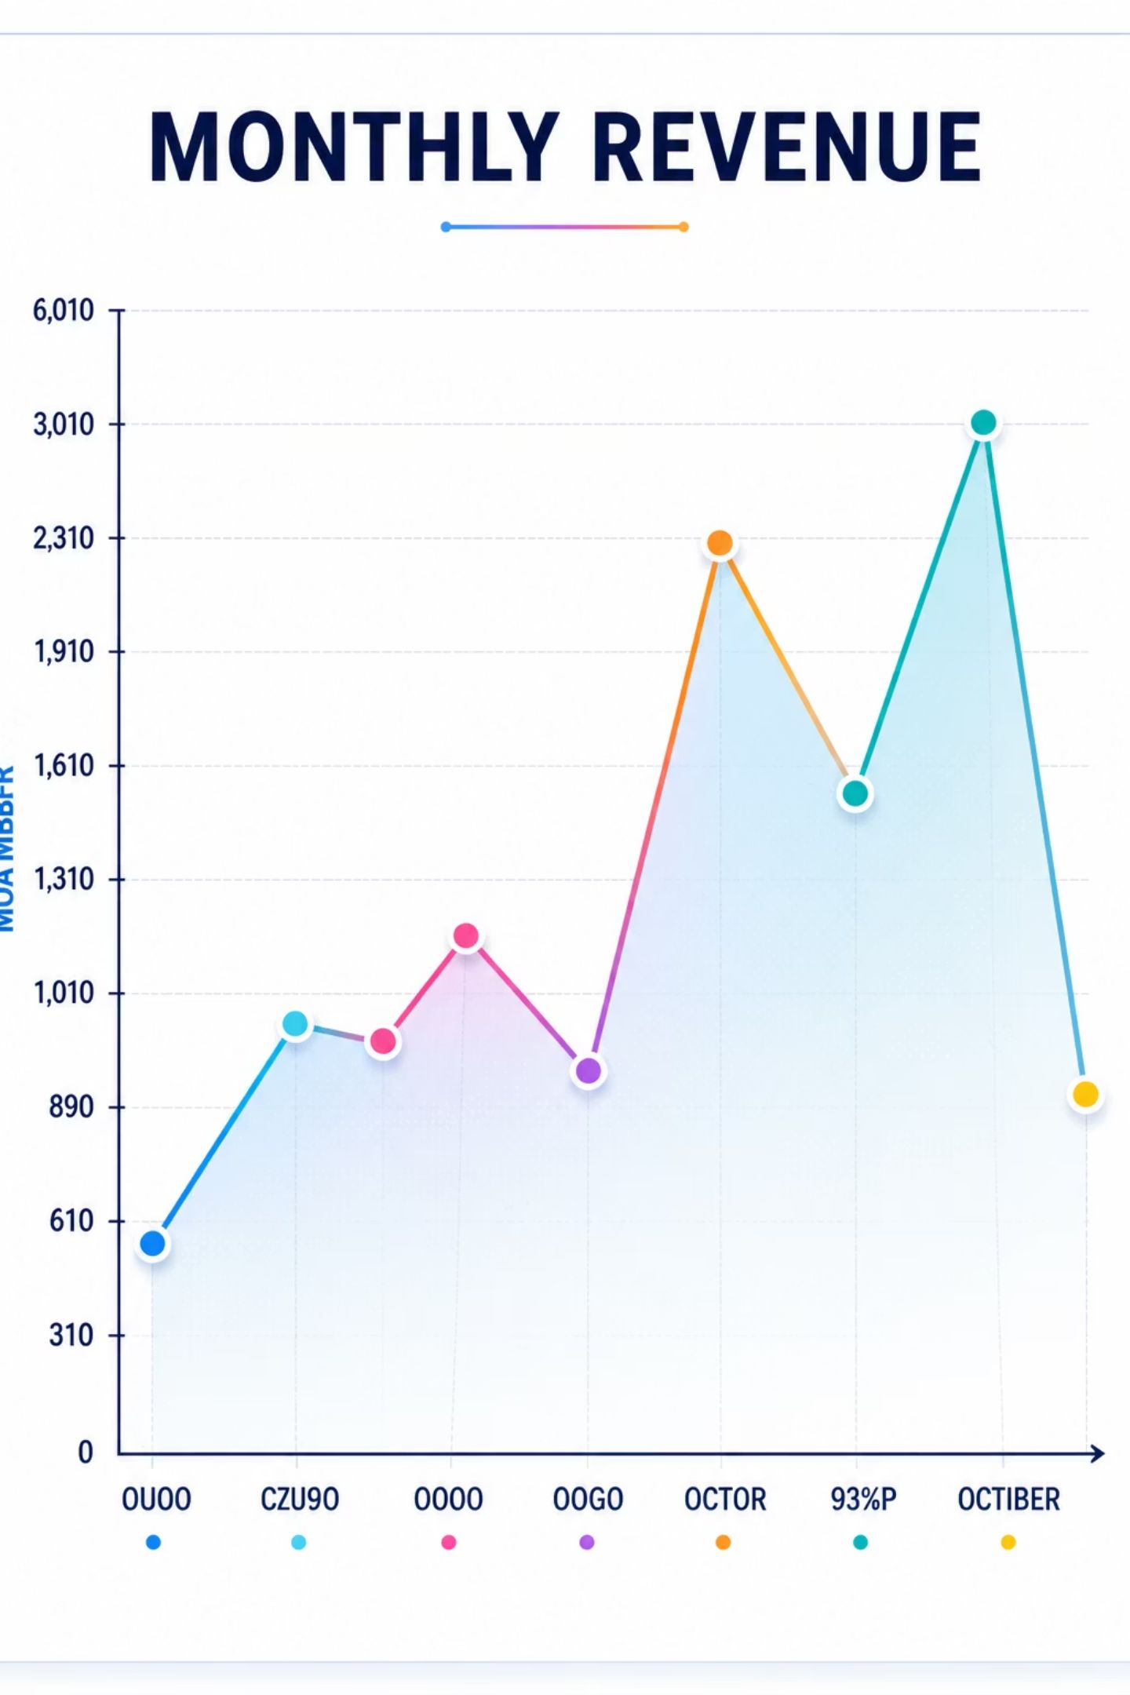
05 • Monthly Revenue Trend
Highlights: September highest revenue: 61,029.27 — October lowest: 17,526.84. Revenue exhibits pronounced month-to-month volatility, suggesting seasonality or campaign-driven spikes.
Action
Next step
Investigate promotions, stockouts, or channel shifts around Sep–Oct to explain volatility.
Overlay marketing calendar and inventory levels to attribute causes.

Slide 7
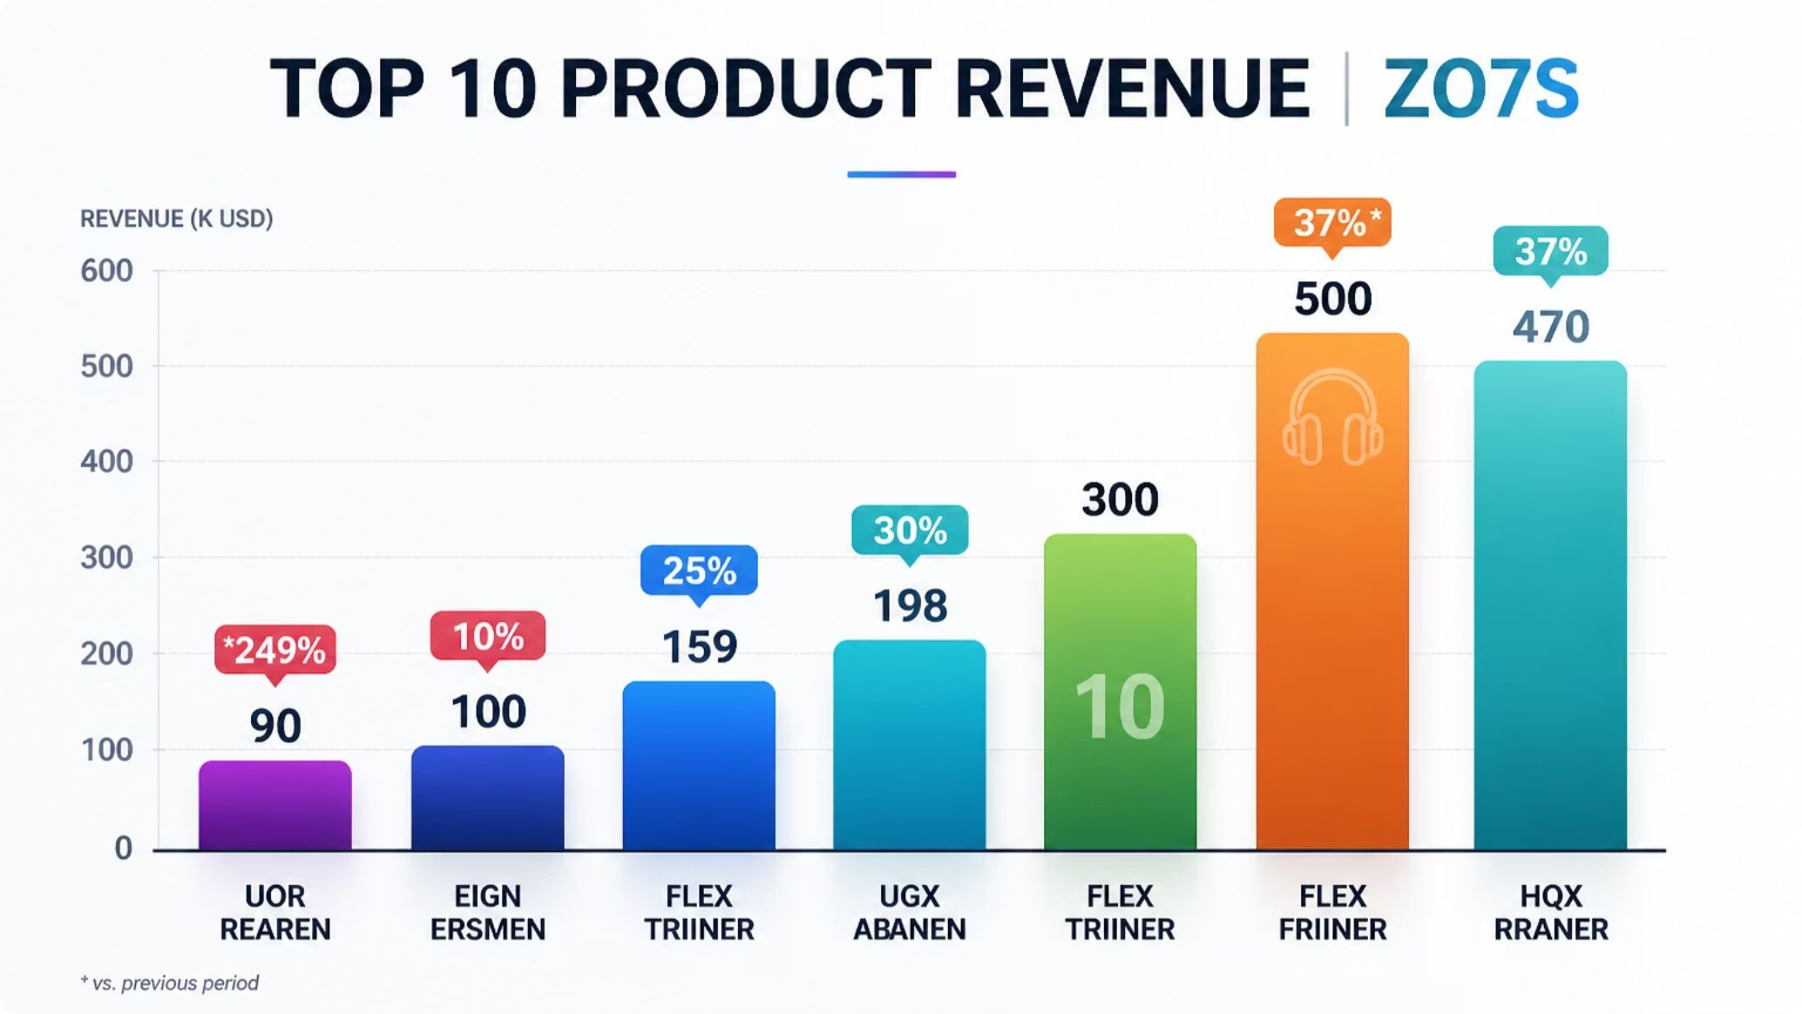

06 • Top Products by Revenue
Top performers (revenue)
LeBron 20 — 42,527.70
Flex Trainer — 41,692.48
ZoomX Invincible — ~39,000
These SKUs drive a disproportionate share of revenue. Review pricing, stock, and cross-sell opportunities for these items.
Consider margin analysis per SKU to prioritize inventory and promotions based on profit, not revenue alone.

Slide 8
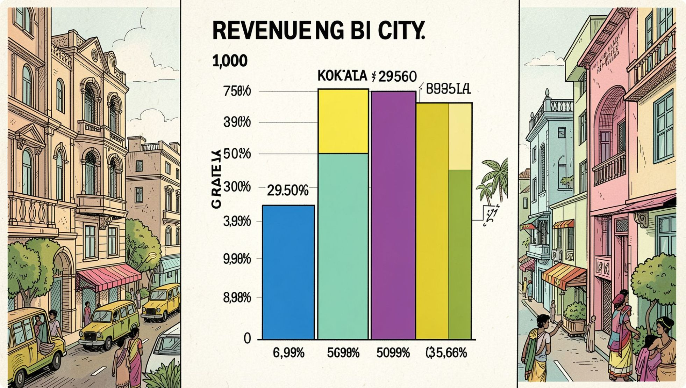
07 • Revenue by Region
Key insight
Kolkata leads with 100,534.03. Significant differences exist across cities — inconsistent region labels (e.g., Hyderabad variants) must be standardized to avoid misleading comparisons.
Recommendation
Apply canonical region mapping and re-run regional KPIs; then prioritize high-revenue cities for local promotions and inventory.

Slide 9
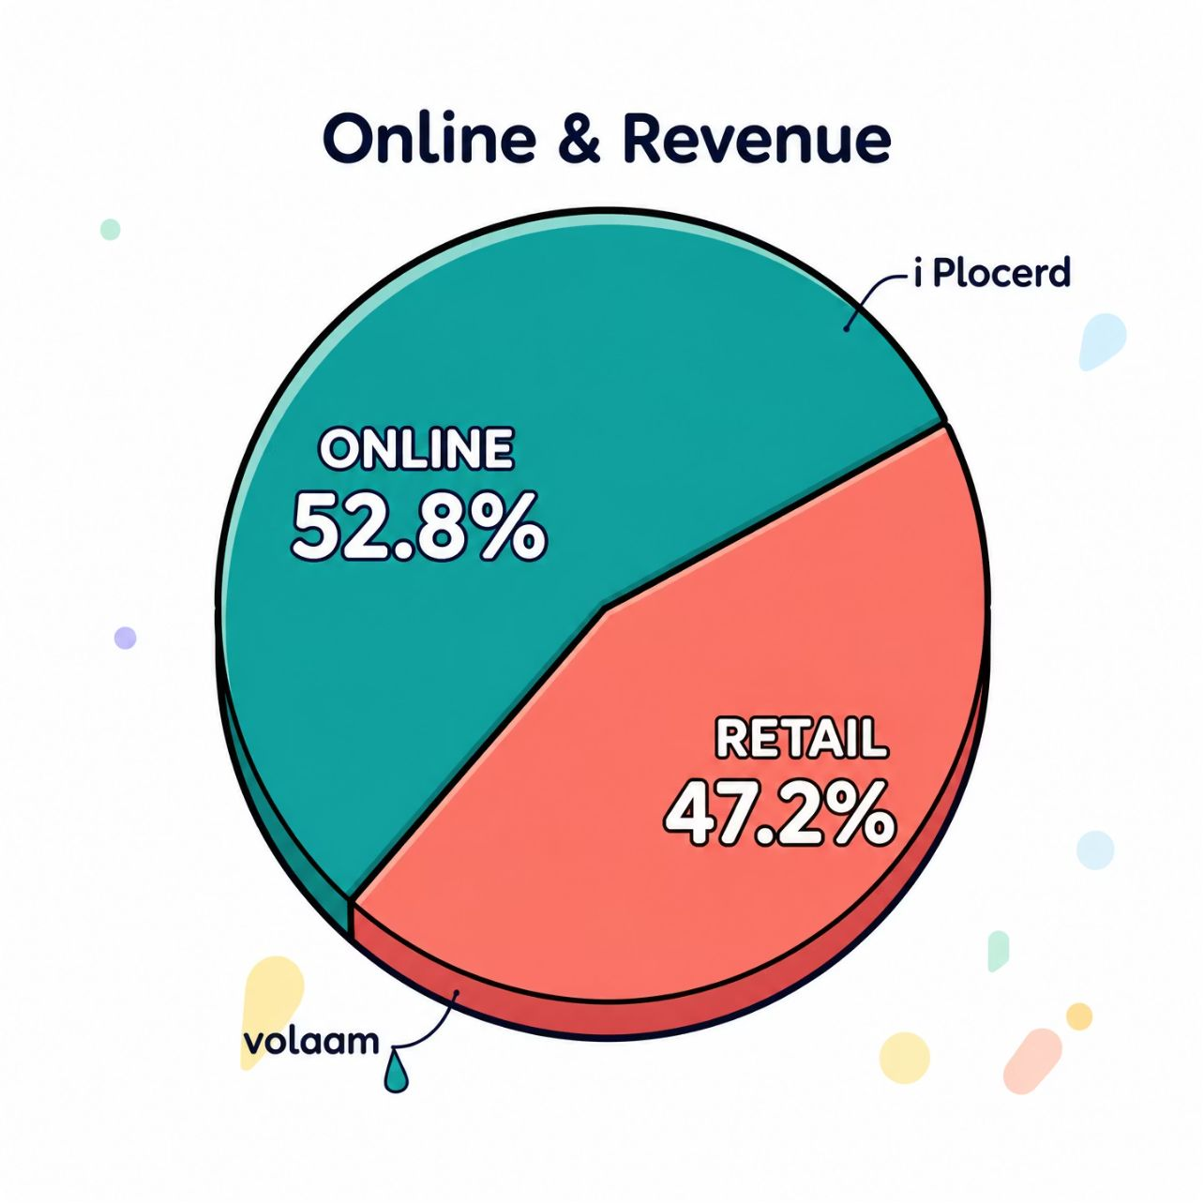
08 • Profit & Channel Diagnostics
Profit by product line
Soccer: 48,098.18 (highest) · Basketball: 42,415.01 · Running: 28,077.19 · Lifestyle: 27,101.28 · Training: 19,289.20
Channel mix is roughly balanced with an online tilt. Combine channel-level margin and fulfillment cost to identify the most profitable distribution strategy.

Slide 10
09 • Conclusion & Recommendations
Key findings
Revenue & products
Regions & channels
Nike sales show strong overall revenue performance, with a clear product and regional concentration. The analysis highlights meaningful differences in profitability, channel efficiency, and market demand.
Revenue is led by a few top-performing product lines, while lower-performing categories offer upside through pricing, promotion, or assortment optimization.
Performance varies by region and distribution channel, suggesting that growth can be improved by focusing investment on the strongest markets and the most efficient sales paths.
01
02
Prioritize best-selling products
Optimize regional strategy
Increase inventory and marketing support for the strongest product lines while reviewing weaker items for repositioning or reduction.
Double down on high-performing regions and tailor campaigns to the needs and purchasing behavior of each market.
03
Improve channel profitability
Balance online and retail execution by comparing margin, fulfillment cost, and conversion efficiency across channels.

Slide 11
Thank You

